Slide 1
Vectors
Twitter: @Owen134866
www.mathsfreeresourcelibrary.com

Slide 2

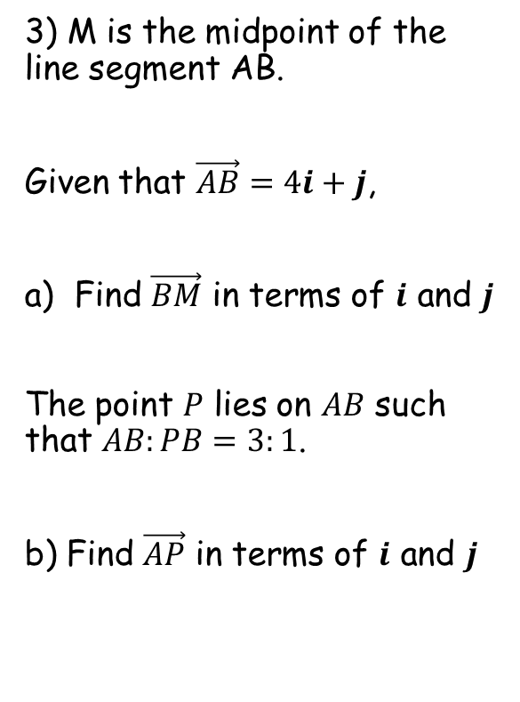

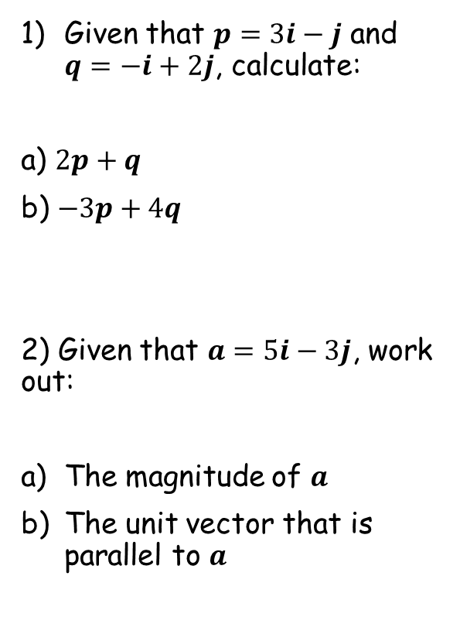




Prior Knowledge Check
Given that $p=3i−j$ and $q=−i+2j$, calculate:
a) $2p+q$
b) $−3p+4q$
2) Given that $a=5i−3j$, work out:
The magnitude of $a$
The unit vector that is parallel to $a$
3) M is the midpoint of the line segment AB.
Given that $\vec{AB}=4i+j$,
Find $\vec{BM}$ in terms of $i$ and $j$
The point $P$ lies on $AB$ such that $AB:PB=3:1$.
b) Find $\vec{AP}$ in terms of $i$ and $j$
$$5i$$
$$−13i+11j$$
$$−2i−\frac{1}{2}j$$
$$\sqrt{34}$$
$$3i+\frac{3}{4}j$$
$$\frac{5}{\sqrt{34}}i−\frac{3}{\sqrt{34}}j$$

Slide 3
Teachings for
Exercise 12A

Slide 4



Vectors
You need to be able to use coordinates in 3 dimensions
Find the distance from the origin to the point P(4, 2, 5)
z
Cartesian coordinates in three dimensions are usually referred to as the x, y and z axes, each at right-angles to the other.
Coordinates in 3 dimensions are given in the form (x, y, z)
5
4
z
y
x
2
Imagine the x and y-axes have fallen down flat, and the z-axis sticks up vertically out of the origin…
You can use the 3D version of Pythagoras’ Theorem
→ The distance from the origin to the point (x, y, z) is given by:
$$\sqrt{x^{2}{+y}^{2}{+z}^{2}}$$
$$=\sqrt{4^{2}{+2}^{2}{+5}^{2}}$$
y
x
$$=6.71$$
(2dp)
12A

Slide 5





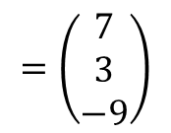

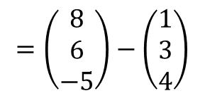

Vectors
$$\vec{AB}=b−a$$
You need to be able to use coordinates in 3 dimensions
Find the distance between the points A(1, 3, 4) and B(8, 6, -5)
Cartesian coordinates in three dimensions are usually referred to as the x, y and z axes, each at right-angles to the other.
Coordinates in 3 dimensions are given in the form (x, y, z)
First calculate the vector from A to B
$$AB=$$
$$b−a$$
$$=\left(\begin{matrix}8 \\ 6 \\ −5\end{matrix}\right)−\left(\begin{matrix}1 \\ 3 \\ 4\end{matrix}\right)$$
$$=\left(\begin{matrix}7 \\ 3 \\ −9\end{matrix}\right)$$
z
$$\sqrt{7^{2}+3^{2}+{(−9)}^{2}}$$
Then use 3D Pythagoras
$$|AB|=$$
$$= \sqrt{139}$$
$$=11.8$$
(1dp)
y
x
12A

Slide 6

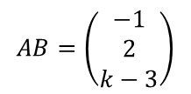

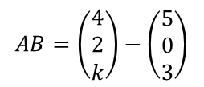






Vectors
$$\vec{AB}=b−a$$
The coordinates of A and B are (5, 0, 3) and (4, 2, k) respectively. Given that |AB| is 3 units, find the possible values of k
You need to be able to use coordinates in 3 dimensions
$$AB=\left(\begin{matrix}4 \\ 2 \\ k\end{matrix}\right)−\left(\begin{matrix}5 \\ 0 \\ 3\end{matrix}\right)$$
Cartesian coordinates in three dimensions are usually referred to as the x, y and z axes, each at right-angles to the other.
Coordinates in 3 dimensions are given in the form (x, y, z)
Calculate $AB$ using k
$$AB=\left(\begin{matrix}−1 \\ 2 \\ k−3\end{matrix}\right)$$
Use Pythagoras in 3D
z
$$\left|AB\right|=\sqrt{{(−1)}^{2}+2^{2}+{(k−3)}^{2}}$$
Careful when squaring the bracket
$$\left|AB\right|=\sqrt{k^{2}−6k+14}$$
|AB| = 3
$$3=\sqrt{k^{2}−6k+14}$$
Square both sides
$$9=k^{2}−6k+14$$
Solve as a quadratic
$$0=k^{2}−6k+5$$
y
$$0=(k−5)(k−1)$$
x
$$k=5 or k=1$$
12A

Slide 7
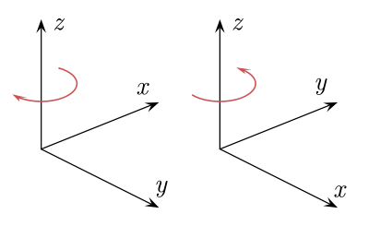
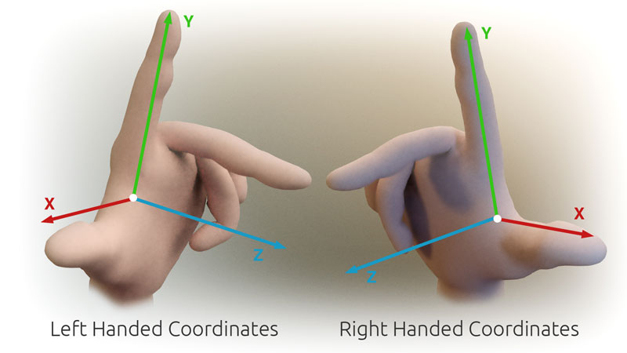
Vectors
$$\vec{AB}=b−a$$
You need to be able to use coordinates in 3 dimensions
Please note that when operating in 3D, there can be some inconsistencies with which way the axes are labelled!
Sometimes referred to as left handed or right handed!
12A

Slide 8
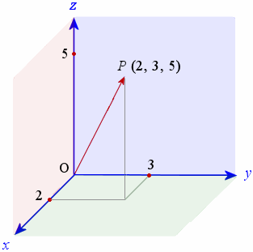
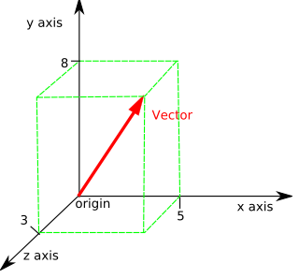
Vectors
$$\vec{AB}=b−a$$
You need to be able to use coordinates in 3 dimensions
Stick to this way!
Please note that when operating in 3D, there can be some inconsistencies with which way the axes are labelled!
12A

Slide 9
Teachings for
Exercise 12B

Slide 10



Vectors
$$\vec{AB}=b−a$$
You need to be able to use vectors to describe movement in 3 dimensions
You can use 3D vectors to describe movement in 3 dimensions
$$k=\left(\begin{matrix}0 \\ 0 \\ 1\end{matrix}\right)$$
A movement one unit in the z-direction
$$i=\left(\begin{matrix}1 \\ 0 \\ 0\end{matrix}\right)$$
z
A movement one unit in the x-direction
$$j=\left(\begin{matrix}0 \\ 1 \\ 0\end{matrix}\right)$$
A movement one unit in the y-direction
y
x
12B

Slide 11

Vectors
$$\vec{AB}=b−a$$
You need to be able to use vectors to describe movement in 3 dimensions
You can use 3D vectors to describe movement in 3 dimensions
z
For any vector in 3 dimensions:
$$pi+qj+rk=\left(\begin{matrix}p \\ q \\ r\end{matrix}\right)$$
y
x
12B

Slide 12

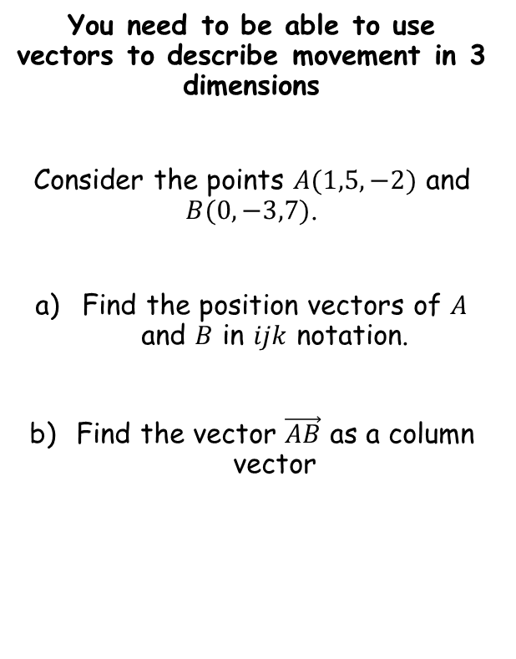

Vectors
$$\vec{AB}=b−a$$
You need to be able to use vectors to describe movement in 3 dimensions
Consider the points $A(1,5,−2)$ and $B(0,−3,7)$.
Find the position vectors of $A$ and $B$ in $ijk$ notation.
Find the vector $\vec{AB}$ as a column vector
The position vector of a point is the vector to get to it from (0,0,0)
$$\vec{OA}=i+5j−2k$$
$$\vec{OB}=−3j+7k$$
12B

Slide 13

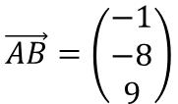
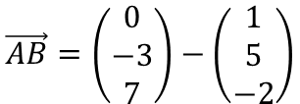


Vectors
$$\vec{AB}=b−a$$
You need to be able to use vectors to describe movement in 3 dimensions
Consider the points $A(1,5,−2)$ and $B(0,−3,7)$.
Find the position vectors of $A$ and $B$ in $ijk$ notation.
Find the vector $\vec{AB}$ as a column vector
$$\vec{AB}=b−a$$
Sub in the vectors we have as columns
$$\vec{AB}=\left(\begin{matrix}0 \\ −3 \\ 7\end{matrix}\right)−\left(\begin{matrix}1 \\ 5 \\ −2\end{matrix}\right)$$
Calculate
$$\vec{AB}=\left(\begin{matrix}−1 \\ −8 \\ 9\end{matrix}\right)$$
$$\vec{OA}=i+5j−2k$$
$$\vec{OB}=−3j+7k$$
12B

Slide 14



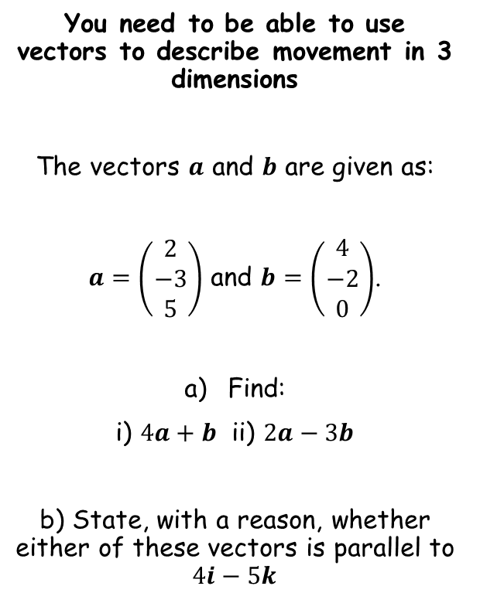
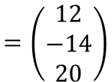
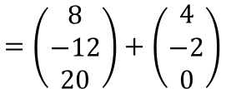
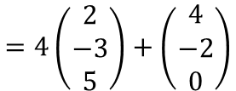
Vectors
$$\vec{AB}=b−a$$
You need to be able to use vectors to describe movement in 3 dimensions
The vectors $a$ and $b$ are given as:
$a=\left(\begin{matrix}2 \\ −3 \\ 5\end{matrix}\right)$ and $b=\left(\begin{matrix}4 \\ −2 \\ 0\end{matrix}\right)$.
Find:
i) $4a+b$ ii) $2a−3b$
b) State, with a reason, whether either of these vectors is parallel to $4i−5k$
$$4a+b$$
Sub in $a$ and $b$
$$=4\left(\begin{matrix}2 \\ −3 \\ 5\end{matrix}\right)+\left(\begin{matrix}4 \\ −2 \\ 0\end{matrix}\right)$$
Multiply the first by 4
$$=\left(\begin{matrix}8 \\ −12 \\ 20\end{matrix}\right)+\left(\begin{matrix}4 \\ −2 \\ 0\end{matrix}\right)$$
$$=\left(\begin{matrix}12 \\ −14 \\ 20\end{matrix}\right)$$
Add together
$$4a+b=\left(\begin{matrix}12 \\ −14 \\ 20\end{matrix}\right)$$
12B

Slide 15

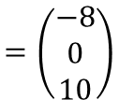
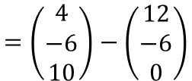
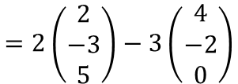

Vectors
$$\vec{AB}=b−a$$
You need to be able to use vectors to describe movement in 3 dimensions
The vectors $a$ and $b$ are given as:
$a=\left(\begin{matrix}2 \\ −3 \\ 5\end{matrix}\right)$ and $b=\left(\begin{matrix}4 \\ −2 \\ 0\end{matrix}\right)$.
Find:
i) $4a+b$ ii) $2a−3b$
b) State, with a reason, whether either of these vectors is parallel to $4i−5k$
$$2a−3b$$
Sub in $a$ and $b$
$$=2\left(\begin{matrix}2 \\ −3 \\ 5\end{matrix}\right)−3\left(\begin{matrix}4 \\ −2 \\ 0\end{matrix}\right)$$
Multiply the first by 2 and the second by 3
$$=\left(\begin{matrix}4 \\ −6 \\ 10\end{matrix}\right)−\left(\begin{matrix}12 \\ −6 \\ 0\end{matrix}\right)$$
$$=\left(\begin{matrix}−8 \\ 0 \\ 10\end{matrix}\right)$$
Add together
$$4a+b=\left(\begin{matrix}12 \\ −14 \\ 20\end{matrix}\right)$$
$$2a−3b=\left(\begin{matrix}−8 \\ 0 \\ 10\end{matrix}\right)$$
12B

Slide 16
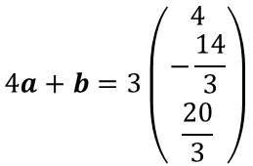
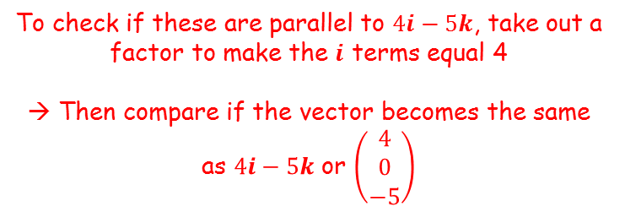




Vectors
$$\vec{AB}=b−a$$
To check if these are parallel to $4i−5k$, take out a factor to make the $i$ terms equal 4
→ Then compare if the vector becomes the same as $4i−5k$ or $\left(\begin{matrix}4 \\ 0 \\ −5\end{matrix}\right)$
You need to be able to use vectors to describe movement in 3 dimensions
The vectors $a$ and $b$ are given as:
$a=\left(\begin{matrix}2 \\ −3 \\ 5\end{matrix}\right)$ and $b=\left(\begin{matrix}4 \\ −2 \\ 0\end{matrix}\right)$.
Find:
i) $4a+b$ ii) $2a−3b$
b) State, with a reason, whether either of these vectors is parallel to $4i−5k$
$$4a+b=\left(\begin{matrix}12 \\ −14 \\ 20\end{matrix}\right)$$
$$2a−3b=\left(\begin{matrix}−8 \\ 0 \\ 10\end{matrix}\right)$$
$$4a+b=3\left(\begin{matrix}4 \\ −\frac{14}{3} \\ \frac{20}{3}\end{matrix}\right)$$
$$2a−3b=−2\left(\begin{matrix}4 \\ 0 \\ −5\end{matrix}\right)$$
So only this one is parallel to $4i−5k$
$$4a+b=\left(\begin{matrix}12 \\ −14 \\ 20\end{matrix}\right)$$
$$2a−3b=\left(\begin{matrix}−8 \\ 0 \\ 10\end{matrix}\right)$$
12B

Slide 17






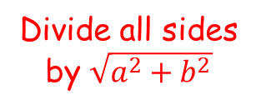

Vectors
$$\vec{AB}=b−a$$
Imagine we represent the vector $ai+bj$ (in 2 dimensions) using a right angled triangle, and calculate its magnitude
You need to be able to use vectors to describe movement in 3 dimensions
→ You also need to be able to calculate unit vectors…
$$\sqrt{a^{2}+b^{2}}$$
$$b$$
$$a$$
The second triangle is a unit vector (meaning it has a magnitude of 1), but in the same direction as the original vector…
So to find a unit vector parallel to another vector, divide all terms by the original vector’s magnitude…
This process also works in 3D!
Divide all sides by $\sqrt{a^{2}+b^{2}}$
$$1$$
$$\frac{b}{\sqrt{a^{2}+b^{2}}}$$
$$\frac{a}{\sqrt{a^{2}+b^{2}}}$$
12B

Slide 18
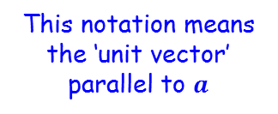


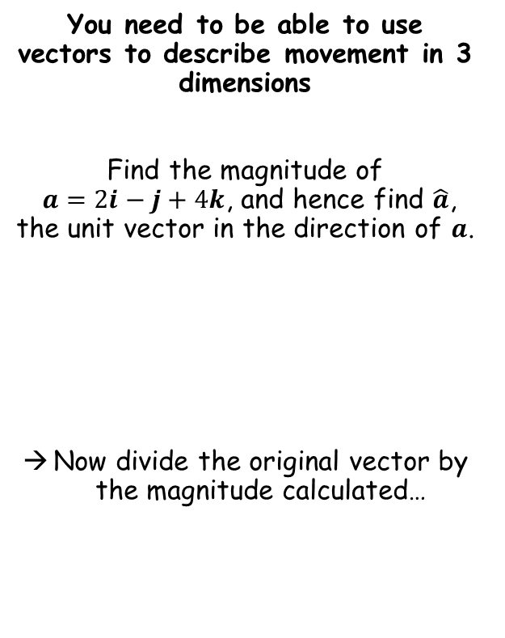



Vectors
$$\vec{AB}=b−a$$
You need to be able to use vectors to describe movement in 3 dimensions
Find the magnitude of
$a=2i−j+4k$, and hence find $\hat{a}$, the unit vector in the direction of $a$.
Now divide the original vector by the magnitude calculated…
$$a=2i−j+4k$$
Divide by $\left|a\right|$
$$\hat{a}=\frac{1}{\sqrt{21}}\left(2i−j+4k \right)$$
This notation means the ‘unit vector’ parallel to $a$
$$\left|a\right|=\sqrt{{(2)}^{2}+{(−1)}^{2}+{(4)}^{2}}$$
Calculate and leave as a surd
$$\left|a\right|=\sqrt{21}$$
12B

Slide 19



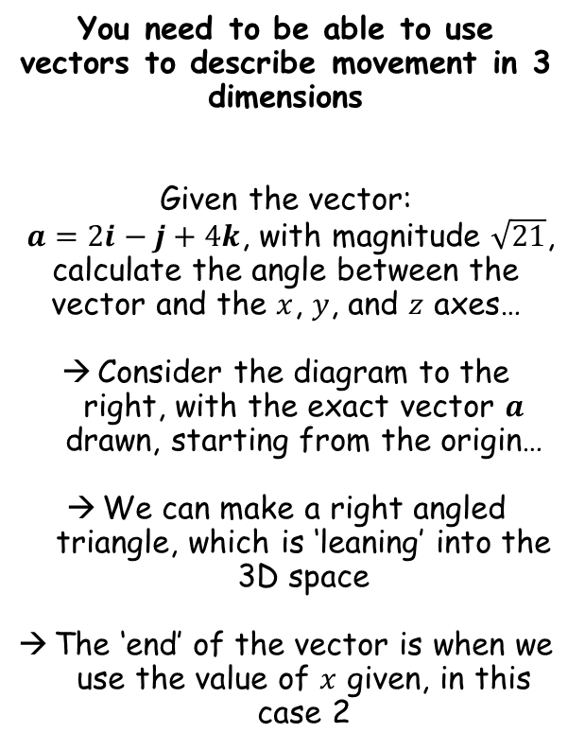




Vectors
$$\vec{AB}=b−a$$
z
You need to be able to use vectors to describe movement in 3 dimensions
Given the vector:
$a=2i−j+4k$, with magnitude $\sqrt{21}$, calculate the angle between the vector and the $x$, $y$, and $z$ axes…
Consider the diagram to the right, with the exact vector $a$ drawn, starting from the origin…
We can make a right angled triangle, which is ‘leaning’ into the 3D space
The ‘end’ of the vector is when we use the value of $x$ given, in this case 2
y
$$a$$
$$\left|a\right|$$
$$θ_{x}$$
$$x$$
x
$$Cosθ=\frac{Adj}{Hyp}$$
Sub in letters from the diagram
$$Cosθ_{x}=\frac{x}{\left|a\right|}$$
Sub in values from the diagram
$$Cosθ_{x}=\frac{2}{\sqrt{21}}$$
Inverse cos
$$θ_{x}=64.1^{°}$$
12B

Slide 20


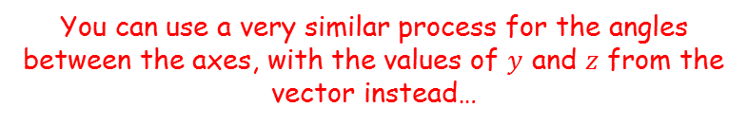

Vectors
$$\vec{AB}=b−a$$
z
You need to be able to use vectors to describe movement in 3 dimensions
Given the vector:
$a=2i−j+4k$, with magnitude $\sqrt{21}$, calculate the angle between the vector and the $x$, $y$, and $z$ axes…
Consider the diagram to the right, with the exact vector $a$ drawn, starting from the origin…
We can make a right angled triangle, which is ‘leaning’ into the 3D space
The ‘end’ of the vector is when we use the value of $x$ given, in this case 2
y
$$a$$
$$\left|a\right|$$
$$θ_{x}$$
$$x$$
x
You can use a very similar process for the angles between the axes, with the values of $y$ and $z$ from the vector instead…
$$Cosθ_{y}=\frac{y}{\left|a\right|}$$
Sub in values from the diagram
$$Cosθ_{y}=\frac{−1}{\sqrt{21}}$$
Inverse cos
$$θ_{y}=102.6^{°}$$
12B

Slide 21



Vectors
$$\vec{AB}=b−a$$
z
You need to be able to use vectors to describe movement in 3 dimensions
Given the vector:
$a=2i−j+4k$, with magnitude $\sqrt{21}$, calculate the angle between the vector and the $x$, $y$, and $z$ axes…
Consider the diagram to the right, with the exact vector $a$ drawn, starting from the origin…
We can make a right angled triangle, which is ‘leaning’ into the 3D space
The ‘end’ of the vector is when we use the value of $x$ given, in this case 2
y
$$a$$
$$\left|a\right|$$
$$θ_{x}$$
$$x$$
x
You can use a very similar process for the angles between the axes, with the values of $y$ and $z$ from the vector instead…
$$Cosθ_{z}=\frac{z}{\left|a\right|}$$
Sub in values from the diagram
$$Cosθ_{z}=\frac{4}{\sqrt{21}}$$
Inverse cos
$$θ_{z}=29.2^{°}$$
12B

Slide 22



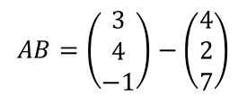












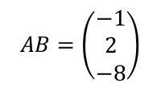


Vectors
$$\vec{AB}=b−a$$
You need to be able to use vectors to describe movement in 3 dimensions
The points $A$ and $B$ have position vectors $4i+2j+7k$ and $3i+4j−k$ relative to a fixed origin O. Find $\vec{AB}$ and show that $∆OAB$ is isosceles.
$$AB=b−a$$
Find the vector AB
$$AB=\left(\begin{matrix}3 \\ 4 \\ −1\end{matrix}\right)−\left(\begin{matrix}4 \\ 2 \\ 7\end{matrix}\right)$$
$$AB=\left(\begin{matrix}−1 \\ 2 \\ −8\end{matrix}\right)$$
$$|AB|=\sqrt{{(−1)}^{2}+2^{2}+{(−8)}^{2}}$$
Now find the magnitude of AB
Sketch (not to scale)
$$A$$
$$|AB|=\sqrt{69}$$
$$\left(\begin{matrix}4 \\ 2 \\ 7\end{matrix}\right)$$
$$\left(\begin{matrix}−1 \\ 2 \\ −8\end{matrix}\right)$$
$$|OA|=\sqrt{4^{2}+2^{2}+7^{2}}$$
$$|OA|=\sqrt{69}$$
Find the magnitude of OA and OB using their position vectors
$$\sqrt{69}$$
$$\sqrt{69}$$
$$|OB|=\sqrt{3^{2}+4^{2}+{(−1)}^{2}}$$
$$O$$
$$\left(\begin{matrix}3 \\ 4 \\ −1\end{matrix}\right)$$
$$B$$
$$|OB|=\sqrt{26}$$
Isosceles as 2 vectors have equal magnitudes
$$\sqrt{26}$$
12B

Slide 23
Teachings for
Exercise 12C

Slide 24
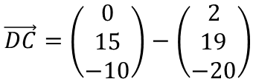



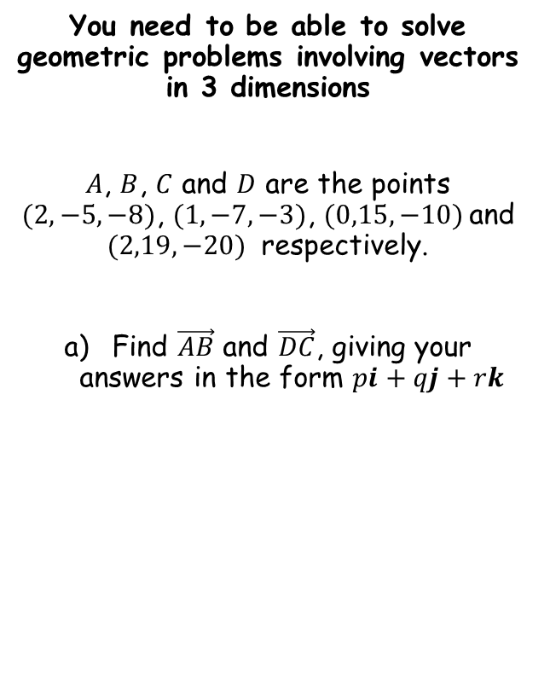


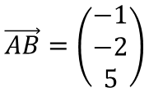

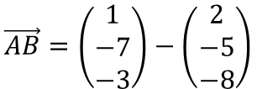
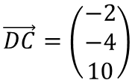
Vectors
$$\vec{AB}=\vec{OB}−\vec{OA}$$
You need to be able to solve geometric problems involving vectors in 3 dimensions
$A$, $B$, $C$ and $D$ are the points $(2,−5,−8)$, $(1,−7,−3)$, $(0,15,−10)$and $(2,19,−20)$ respectively.
Find $\vec{AB}$ and $\vec{DC}$, giving your answers in the form $pi+qj+rk$
Sub in values
$$\vec{AB}=\left(\begin{matrix}1 \\ −7 \\ −3\end{matrix}\right)−\left(\begin{matrix}2 \\ −5 \\ −8\end{matrix}\right)$$
Calculate
$$\vec{AB}=\left(\begin{matrix}−1 \\ −2 \\ 5\end{matrix}\right)$$
Write in the form specified
$$\vec{AB}=−i−2j+5k$$
$$\vec{DC}=\vec{OC}−\vec{OD}$$
$$\vec{AB}=−i−2j+5k$$
$$\vec{DC}=−2i−4j+10k$$
Sub in values
$$\vec{DC}=\left(\begin{matrix}0 \\ 15 \\ −10\end{matrix}\right)−\left(\begin{matrix}2 \\ 19 \\ −20\end{matrix}\right)$$
Calculate
$$\vec{DC}=\left(\begin{matrix}−2 \\ −4 \\ 10\end{matrix}\right)$$
Write in the form specified
$$\vec{DC}=−2i−4j+10k$$
12C

Slide 25

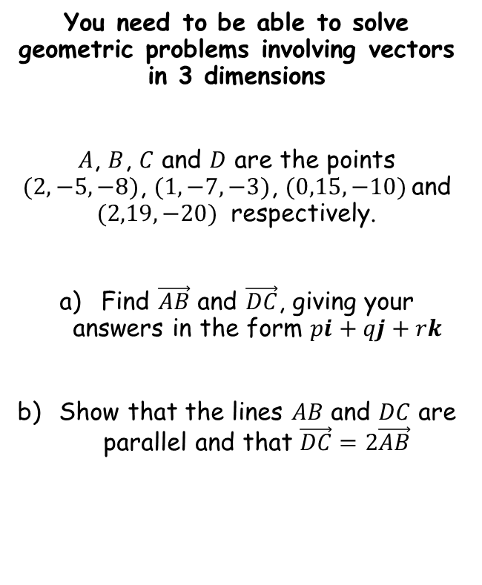


Vectors
You need to be able to solve geometric problems involving vectors in 3 dimensions
$A$, $B$, $C$ and $D$ are the points $(2,−5,−8)$, $(1,−7,−3)$, $(0,15,−10)$and $(2,19,−20)$ respectively.
Find $\vec{AB}$ and $\vec{DC}$, giving your answers in the form $pi+qj+rk$
Show that the lines $AB$ and $DC$ are parallel and that $\vec{DC}=2\vec{AB}$
$$\vec{DC}=−2i−4j+10k$$
Factorise right side
$$\vec{DC}=2(−i−2j+5k)$$
Replace
$$\vec{DC}=2\vec{AB}$$
$$\vec{AB}=−i−2j+5k$$
$$\vec{DC}=−2i−4j+10k$$
12C

Slide 26


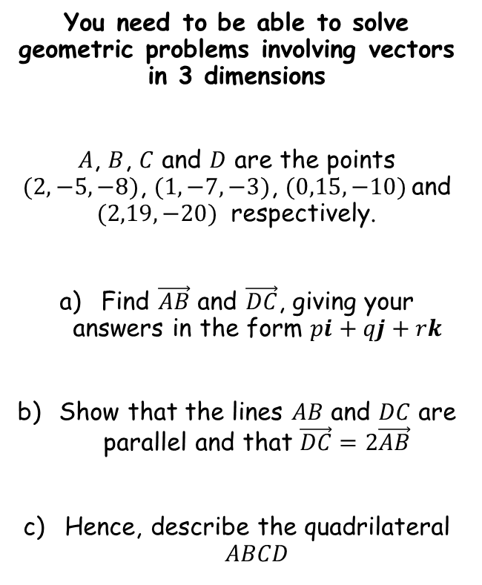


Vectors
You need to be able to solve geometric problems involving vectors in 3 dimensions
$A$, $B$, $C$ and $D$ are the points $(2,−5,−8)$, $(1,−7,−3)$, $(0,15,−10)$and $(2,19,−20)$ respectively.
Find $\vec{AB}$ and $\vec{DC}$, giving your answers in the form $pi+qj+rk$
Show that the lines $AB$ and $DC$ are parallel and that $\vec{DC}=2\vec{AB}$
Hence, describe the quadrilateral $ABCD$
Since we have 2 unequal parallel sides, the quadrilateral must be a trapezium…
$$\vec{AB}=−i−2j+5k$$
$$\vec{DC}=−2i−4j+10k$$
$$C$$
$$D$$
$$B$$
$$A$$
12C

Slide 27





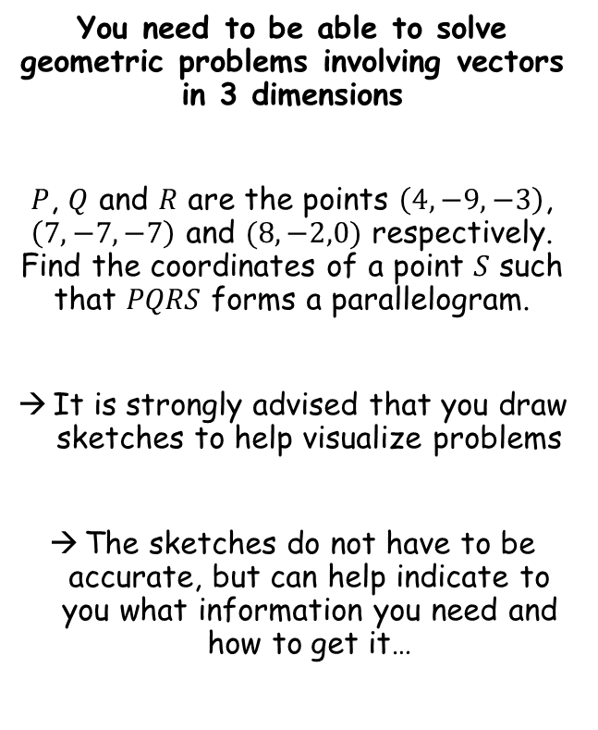
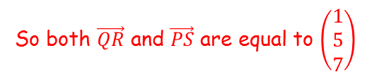




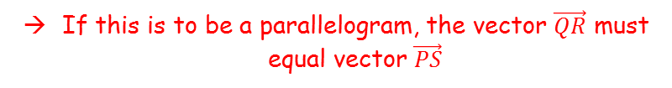



Vectors
The letters given will always be clockwise or anticlockwise around the shape…
You need to be able to solve geometric problems involving vectors in 3 dimensions
$P$, $Q$ and $R$ are the points $\left(4,−9,−3\right)$, $\left(7, −7, −7\right)$ and $(8,−2,0)$ respectively. Find the coordinates of a point $S$ such that $PQRS$ forms a parallelogram.
It is strongly advised that you draw sketches to help visualize problems
The sketches do not have to be accurate, but can help indicate to you what information you need and how to get it…
$$\left(4,−9,−3\right)$$
$$P$$
$$\left(7, −7, −7\right)$$
$$Q$$
$$\left(\begin{matrix}1 \\ 5 \\ 7\end{matrix}\right)$$
$$\left(\begin{matrix}1 \\ 5 \\ 7\end{matrix}\right)$$
$$(8,−2,0)$$
$$S$$
$$R$$
If this is to be a parallelogram, the vector $\vec{QR}$ must equal vector $\vec{PS}$
$$\vec{QR}=\vec{OR}−\vec{OQ}$$
Sub in values
$$\vec{QR}=\left(\begin{matrix}8 \\ −2 \\ 0\end{matrix}\right)−\left(\begin{matrix}7 \\ −7 \\ −7\end{matrix}\right)$$
Calculate
$$\vec{QR}=\left(\begin{matrix}1 \\ 5 \\ 7\end{matrix}\right)$$
So both $\vec{QR}$ and $\vec{PS}$ are equal to $\left(\begin{matrix}1 \\ 5 \\ 7\end{matrix}\right)$
12C

Slide 28
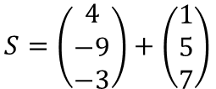


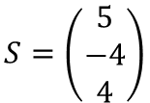
Vectors
The letters given will always be clockwise or anticlockwise around the shape…
You need to be able to solve geometric problems involving vectors in 3 dimensions
$P$, $Q$ and $R$ are the points $\left(4,−9,−3\right)$, $\left(7, −7, −7\right)$ and $(8,−2,0)$ respectively. Find the coordinates of a point $S$ such that $PQRS$ forms a parallelogram.
It is strongly advised that you draw sketches to help visualize problems
The sketches do not have to be accurate, but can help indicate to you what information you need and how to get it…
$$\left(4,−9,−3\right)$$
$$P$$
$$\left(7, −7, −7\right)$$
$$Q$$
$$\left(\begin{matrix}1 \\ 5 \\ 7\end{matrix}\right)$$
$$\left(\begin{matrix}1 \\ 5 \\ 7\end{matrix}\right)$$
$$(8,−2,0)$$
$$S$$
$$R$$
$$S=P+\vec{PS}$$
$$S=\left(\begin{matrix}4 \\ −9 \\ −3\end{matrix}\right)+\left(\begin{matrix}1 \\ 5 \\ 7\end{matrix}\right)$$
Sub in values
Calculate
$$S=\left(\begin{matrix}5 \\ −4 \\ 4\end{matrix}\right)$$
So the point S is $\left(5,−4,4\right)$
12C

Slide 29




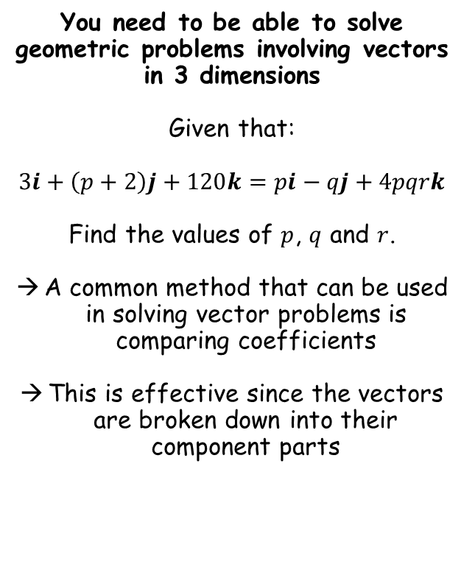






Vectors
$$3i+\left(p+2\right)j+120k=pi−qj+4pqrk$$
You need to be able to solve geometric problems involving vectors in 3 dimensions
Given that:
$$3i+\left(p+2\right)j+120k=pi−qj+4pqrk$$
Find the values of $p$, $q$ and $r$.
A common method that can be used in solving vector problems is comparing coefficients
This is effective since the vectors are broken down into their component parts
If these are equal, then the coefficients of $i$ must be the same on both sides
→ This is also true of the $j$ and $k$ terms…
$$3i=pi$$
It therefore follows that…
$$3=p$$
$$\left(p+2\right)j=−qj$$
It therefore follows that…
$$\left(p+2\right)=−q$$
We already know $p=3$
$$5=−q$$
Multiply by -1
$$−5=q$$
$$p=3$$
$$q=−5$$
12C

Slide 30






Vectors
$$3i+\left(p+2\right)j+120k=pi−qj+4pqrk$$
You need to be able to solve geometric problems involving vectors in 3 dimensions
Given that:
$$3i+\left(p+2\right)j+120k=pi−qj+4pqrk$$
Find the values of $p$, $q$ and $r$.
A common method that can be used in solving vector problems is comparing coefficients
This is effective since the vectors are broken down into their component parts
If these are equal, then the coefficients of $i$ must be the same on both sides
→ This is also true of the $j$ and $k$ terms…
$$120k=4pqrk$$
It therefore follows that…
$$120=4pqr$$
We know the values of $p$ and $q$ now…
$$120=4\left(3\right)\left(−5\right)r$$
Calculate right side
$$120=−60r$$
Divide by -60
$$−2=r$$
$$p=3$$
$$q=−5$$
12C

Slide 31

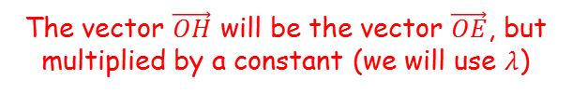



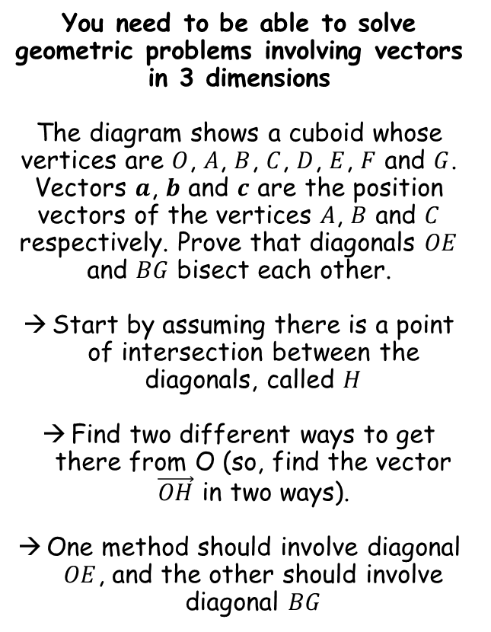











Vectors
$$E$$
$$G$$
You need to be able to solve geometric problems involving vectors in 3 dimensions
The diagram shows a cuboid whose vertices are $O$, $A$, $B$, $C$, $D$, $E$, $F$ and $G$. Vectors $a$, $b$ and $c$ are the position vectors of the vertices $A$, $B$ and $C$ respectively. Prove that diagonals $OE$ and $BG$ bisect each other.
Start by assuming there is a point of intersection between the diagonals, called $H$
Find two different ways to get there from O (so, find the vector $\vec{OH}$ in two ways).
One method should involve diagonal $OE$, and the other should involve diagonal $BG$
$$\vec{OE}=a+b+c$$
$$\vec{BG}=−b+a+c$$
$$F$$
$$C$$
$$H$$
$$c$$
$$D$$
$$A$$
$$a$$
$$B$$
$$b$$
$$O$$
The vector $\vec{OH}$ will be the vector $\vec{OE}$, but multiplied by a constant (we will use $λ$)
$$\vec{OH}=λ\vec{OE}$$
Replace vector $\vec{OE}$ with the expression above
$$\vec{OH}=λ\left(a+b+c \right)$$
Expand the bracket
$$\vec{OH}=λa+λb+λc$$
$$\vec{OH}=λa+λb+λc$$
12C

Slide 32



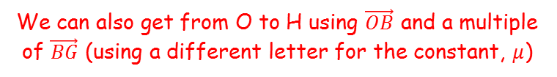


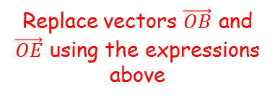

Vectors
$$E$$
$$G$$
You need to be able to solve geometric problems involving vectors in 3 dimensions
The diagram shows a cuboid whose vertices are $O$, $A$, $B$, $C$, $D$, $E$, $F$ and $G$. Vectors $a$, $b$ and $c$ are the position vectors of the vertices $A$, $B$ and $C$ respectively. Prove that diagonals $OE$ and $BG$ bisect each other.
Start by assuming there is a point of intersection between the diagonals, called $H$
Find two different ways to get there from O (so, find the vector $\vec{OH}$ in two ways).
One method should involve diagonal $OE$, and the other should involve diagonal $BG$
$$\vec{OE}=a+b+c$$
$$\vec{BG}=−b+a+c$$
$$F$$
$$C$$
$$H$$
$$c$$
$$D$$
$$A$$
$$a$$
$$B$$
$$b$$
$$O$$
We can also get from O to H using $\vec{OB}$ and a multiple of $\vec{BG}$ (using a different letter for the constant, $μ$)
$$\vec{OH}=\vec{OB}+μ\vec{BG}$$
Replace vectors $\vec{OB}$ and $\vec{OE}$ using the expressions above
$$\vec{OH}=b+μ\left(−b+a+c \right)$$
Expand bracket
$$\vec{OH}=b−μb+μa+μc$$
Rewrite so $a$, $b$ and $c$ terms are together
$$\vec{OH}=λa+λb+λc$$
$$\vec{OH}=μa+\left(1−μ\right)b+μc$$
$$\vec{OH}=μa+\left(1−μ\right)b+μc$$
12C

Slide 33
















Vectors
$$E$$
$$G$$
You need to be able to solve geometric problems involving vectors in 3 dimensions
The diagram shows a cuboid whose vertices are $O$, $A$, $B$, $C$, $D$, $E$, $F$ and $G$. Vectors $a$, $b$ and $c$ are the position vectors of the vertices $A$, $B$ and $C$ respectively. Prove that diagonals $OE$ and $BG$ bisect each other.
$$\vec{OE}=a+b+c$$
$$\vec{BG}=−b+a+c$$
$$F$$
$$C$$
$$H$$
$$c$$
$$D$$
$$A$$
$$a$$
$$B$$
$$b$$
$$O$$
We can now set the two expressions for $\vec{OH}$ equal to each other
$$\vec{OH}=λa+λb+λc$$
$$λa+λb+λc=μa+\left(1−μ\right)b+μc$$
$$\vec{OH}=μa+\left(1−μ\right)b+μc$$
Set $a$ coefficients equal
Set $b$ coefficients equal
$$λ=0.5$$
$$λ=μ$$
$$λ=1−μ$$
Replace $μ$ using the first equation
$$μ=0.5$$
$$λ=1−λ$$
Add $λ$
$$2λ=1$$
Divide by 2
$$λ=0.5$$
12C

Slide 34





Vectors
$$E$$
$$G$$
You need to be able to solve geometric problems involving vectors in 3 dimensions
The diagram shows a cuboid whose vertices are $O$, $A$, $B$, $C$, $D$, $E$, $F$ and $G$. Vectors $a$, $b$ and $c$ are the position vectors of the vertices $A$, $B$ and $C$ respectively. Prove that diagonals $OE$ and $BG$ bisect each other.
$$\vec{OE}=a+b+c$$
$$\vec{BG}=−b+a+c$$
$$F$$
$$C$$
$$H$$
$$c$$
$$D$$
$$A$$
$$a$$
$$B$$
$$b$$
$$O$$
$$\vec{OH}=λa+λb+λc$$
Replace $λ$ terms with 0.5
$$\vec{OH}=λa+λb+λc$$
$$\vec{OH}=0.5a+0.5b+0.5c$$
Factorise
$$\vec{OH}=μa+\left(1−μ\right)b+μc$$
$$\vec{OH}=0.5(a+b+c)$$
We can replace the bracket…
$$λ=0.5$$
$$\vec{OH}=0.5\vec{OE}$$
$$μ=0.5$$
This shows that diagonal $\vec{OH}$ has been bisected…
12C

Slide 35




Vectors
$$E$$
$$G$$
You need to be able to solve geometric problems involving vectors in 3 dimensions
The diagram shows a cuboid whose vertices are $O$, $A$, $B$, $C$, $D$, $E$, $F$ and $G$. Vectors $a$, $b$ and $c$ are the position vectors of the vertices $A$, $B$ and $C$ respectively. Prove that diagonals $OE$ and $BG$ bisect each other.
$$\vec{OE}=a+b+c$$
$$\vec{BG}=−b+a+c$$
$$F$$
$$C$$
$$H$$
$$c$$
$$D$$
$$A$$
$$a$$
$$B$$
$$b$$
$$O$$
Originally, we said that:
$$\vec{OH}=λa+λb+λc$$
$$\vec{BH}=μ\vec{BG}$$
$$\vec{OH}=μa+\left(1−μ\right)b+μc$$
We can replace the $μ$
$$\vec{BH}=0.5\vec{BG}$$
$$λ=0.5$$
This shows that diagonal $\vec{BH}$ has also been bisected…
$$μ=0.5$$
$$\vec{OH}=0.5a+0.5b+0.5c$$
12C

Slide 36
Teachings for
Exercise 12D

Slide 37




Vectors
Replace the forces
You can use 3D vectors to model problems in Mechanics
A particle of mass 0.5kg is acted on by 3 forces:
$$F_{1}=\left(2i−j+2k\right)N$$
$$F_{2}=\left(−i+3j−3k\right)N$$
$$F_{3}=\left(4i−3j−2k\right)N$$
Find the resultant force, $R$, that acts on the particle.
$$R=F_{1}+F_{2}+F_{3}$$
$$R=\left(2i−j+2k\right)+\left(−i+3j−3k\right)+\left(4i−3j−2k\right)$$
$$R=\left(5i−j−3k\right)N$$
Calculate
$$R=\left(5i−j−3k\right)N$$
12D

Slide 38






Vectors
You can use 3D vectors to model problems in Mechanics
A particle of mass 0.5kg is acted on by 3 forces:
$$F_{1}=\left(2i−j+2k\right)N$$
$$F_{2}=\left(−i+3j−3k\right)N$$
$$F_{3}=\left(4i−3j−2k\right)N$$
Find the resultant force, $R$, that acts on the particle.
Find the acceleration of the particle
$$F=ma$$
Sub in the resultant force and the mass
$$\left(5i−j−3k\right)=0.5a$$
Calculate the acceleration (the answer will be in terms of $i$, $j$ and $k$)
$$\left(10i−2j−6k\right)=a$$
$$R=\left(5i−j−3k\right)N$$
$$a=\left(10i−2j−6k\right) {ms}^{−2}$$
12D

Slide 39



Vectors
You can use 3D vectors to model problems in Mechanics
A particle of mass 0.5kg is acted on by 3 forces:
$$F_{1}=\left(2i−j+2k\right)N$$
$$F_{2}=\left(−i+3j−3k\right)N$$
$$F_{3}=\left(4i−3j−2k\right)N$$
Find the resultant force, $R$, that acts on the particle.
Find the acceleration of the particle
Find the magnitude of the acceleration
$$\left|a\right|=\sqrt{{(10)}^{2}+{(−2)}^{2}+{(−6)}^{2}}$$
Calculate
$$\left|a\right|=\sqrt{140} {ms}^{−2}$$
$$R=\left(5i−j−3k\right)N$$
$$a=\left(10i−2j−6k\right) {ms}^{−2}$$
12D

Slide 40











Vectors
$$s= ?$$
$$u=0$$
$$v= ?$$
$$a=\sqrt{140}$$
$$t=6$$
You can use 3D vectors to model problems in Mechanics
A particle of mass 0.5kg is acted on by 3 forces:
$$F_{1}=\left(2i−j+2k\right)N$$
$$F_{2}=\left(−i+3j−3k\right)N$$
$$F_{3}=\left(4i−3j−2k\right)N$$
d) Given that the particle starts at rest, find the distance travelled in the first 6 seconds of its motion
$$s=ut+\frac{1}{2}at^{2}$$
Sub in values
$$s=(0)(6)+\frac{1}{2}\sqrt{140}{(6)}^{2}$$
Calculate
$$s=36\sqrt{35} m$$
$$R=\left(5i−j−3k\right)N$$
$$a=\left(10i−2j−6k\right) {ms}^{−2}$$
$$\left|a\right|=\sqrt{140} {ms}^{−2}$$
12D

